Slide 1
RECOMMENDATION SYSTEMS IN E-COMMERCE WEBSITES
By Radhika Bailurkar (2019430003)
Faculty Incharge: Prof. Nataasha Raul

Slide 2
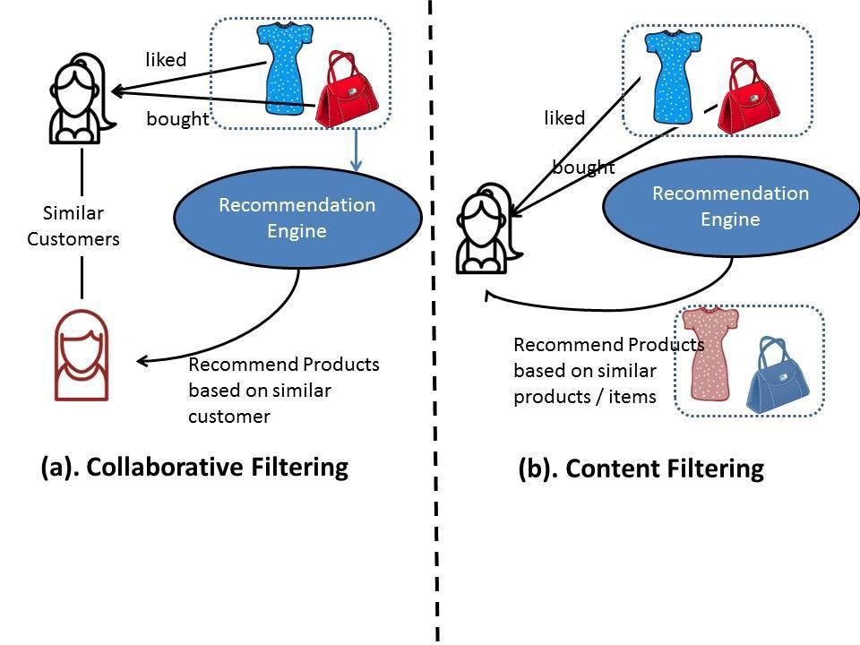
Previously in Phase 1
Content Filtering
Collaborative Filtering
Hybrid Filtering

Slide 3
Comparative Analysis
Phase 2 Docx
https://docs.google.com/document/d/1pcyC2uQAu0yQXEPcPfJFKJlzuf8eHay3s8VbuOoEInE/edit

Slide 4
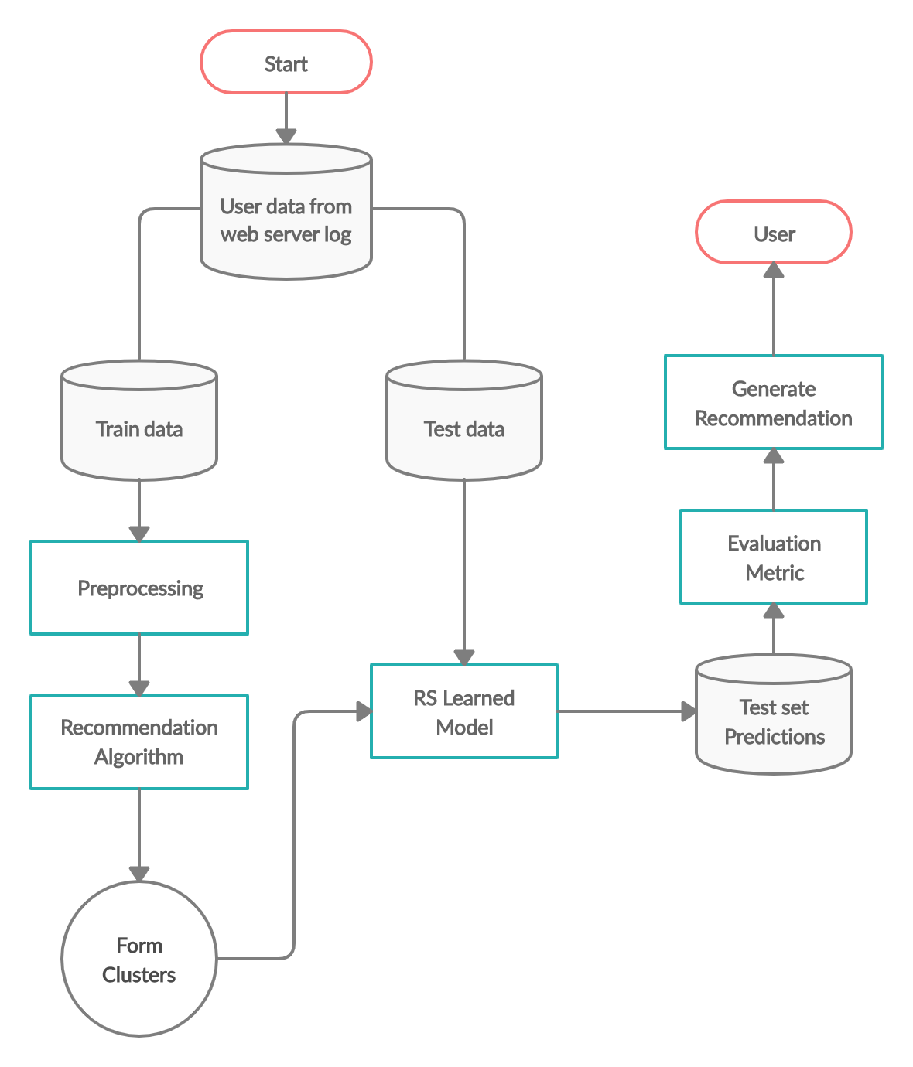
Workflow Model

Slide 5
Implementation - Dataset
Dataset: Amazon Ratings
It contains
the unique UserId (Customer Identification),
the product ASIN (Amazon's unique product identification code for each product),
Ratings (ranging from 1-5 based on customer satisfaction) and
the Timestamp of the rating (in UNIX time)

Slide 6
Kmeans Algorithm
Specify number of clusters K.
Initialize centroids by first shuffling the dataset and then randomly selecting K data points for the centroids without replacement.
Keep iterating until there is no change to the centroids. i.e assignment of data points to clusters isn’t changing.
Compute the sum of the squared distance between data points and all centroids.
Assign each data point to the closest cluster (centroid).
Compute the centroids for the clusters by taking the average of the all data points that belong to each cluster.

Slide 7
References

